Slide 1
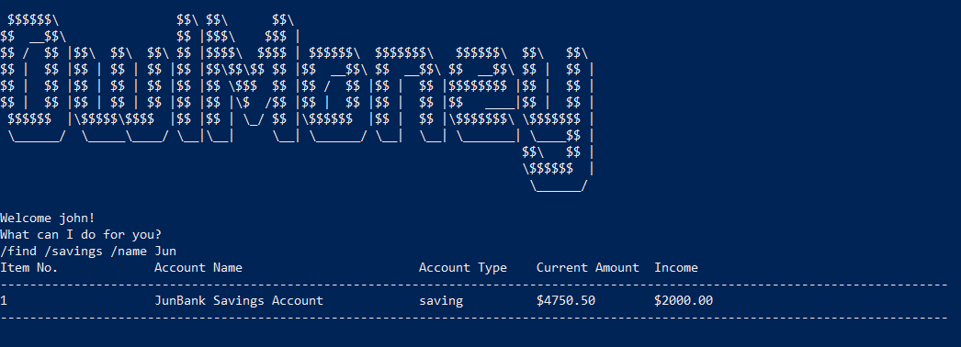
Successful search of savings account
Command entered

Slide 2
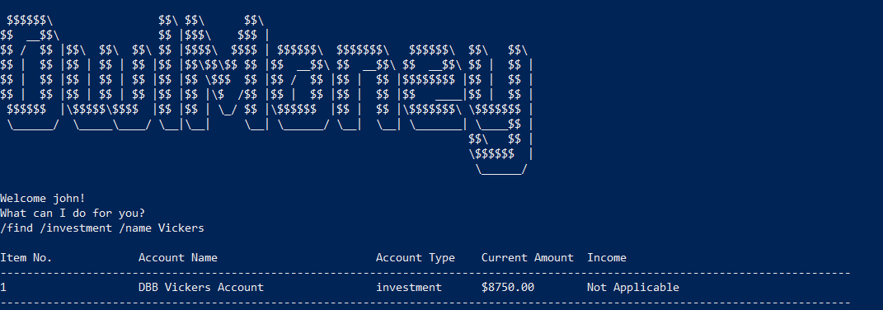
Successful search of investment account
Command entered

Slide 3
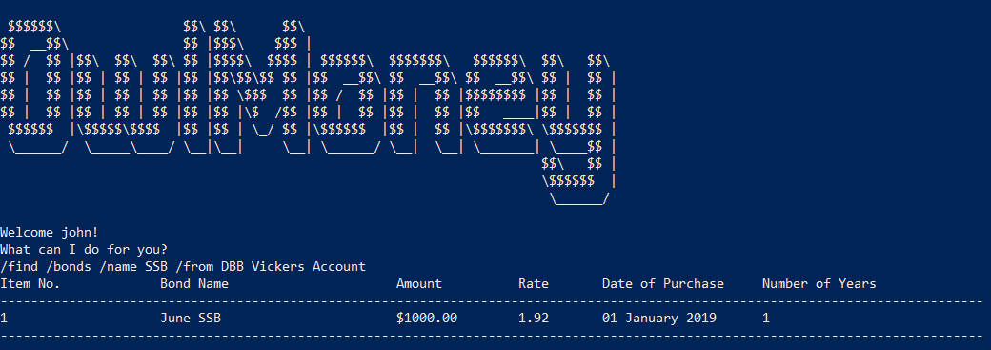
Command entered
Successful search of bonds

Slide 4
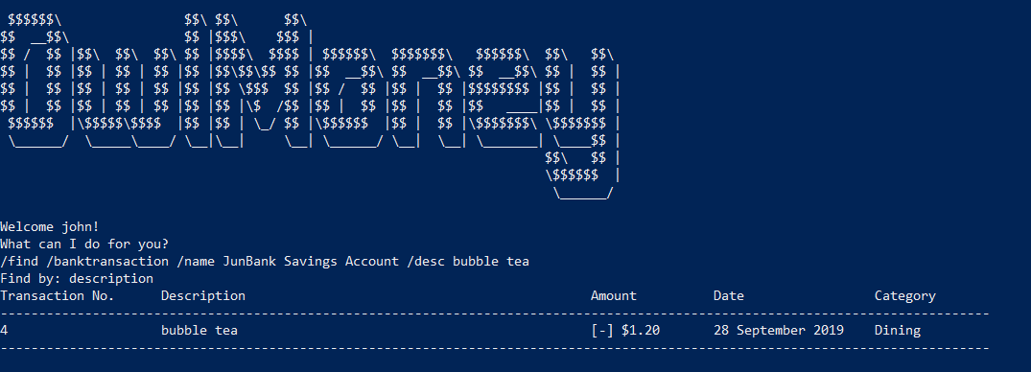
Command entered
Successful search of bank transaction by description

Slide 5
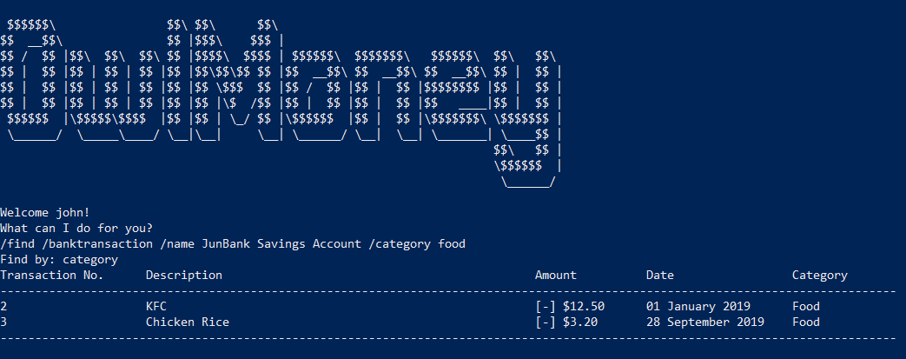
Command entered
Successful search of bank transaction by category

Slide 6
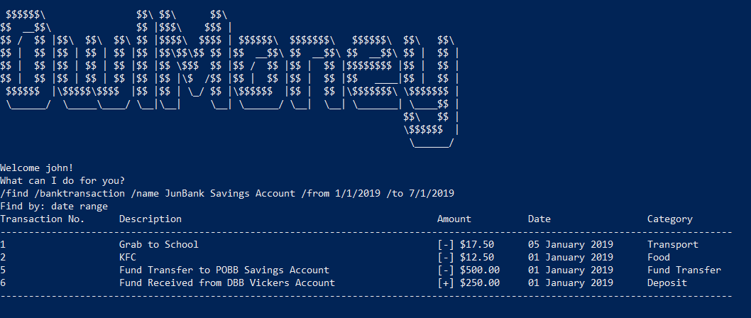
Command entered
Successful search of bank transaction by date range

Slide 7
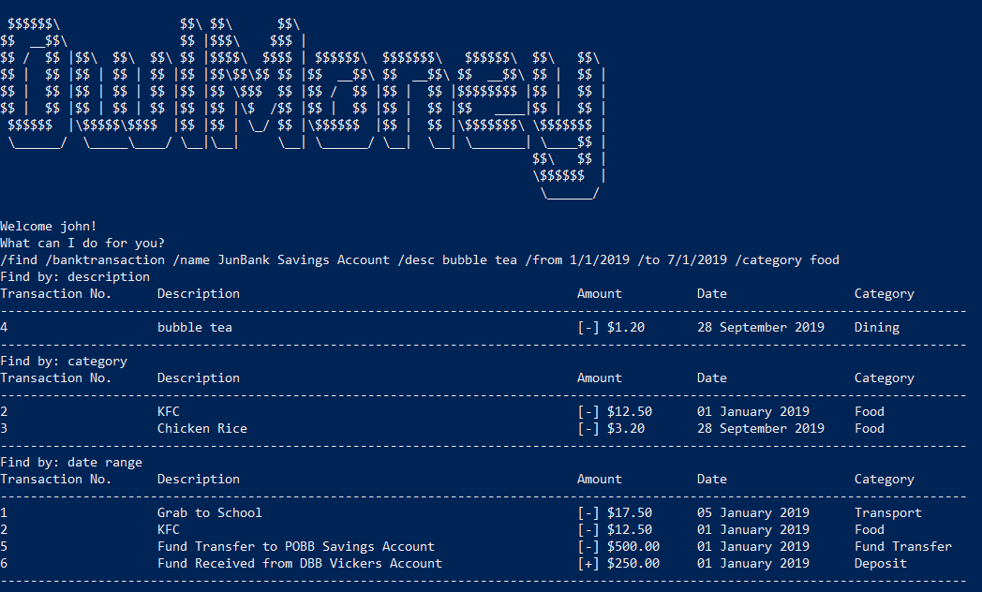
Successful search of bank transaction by description, category and date range
Command entered

Slide 8
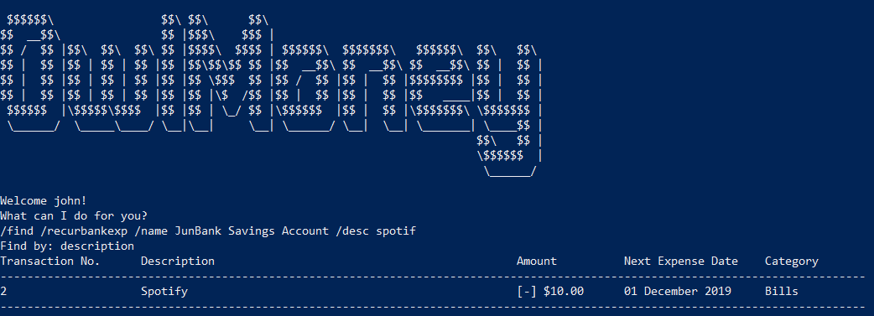
Command entered
Successful search of recurring expenditure by description

Slide 9
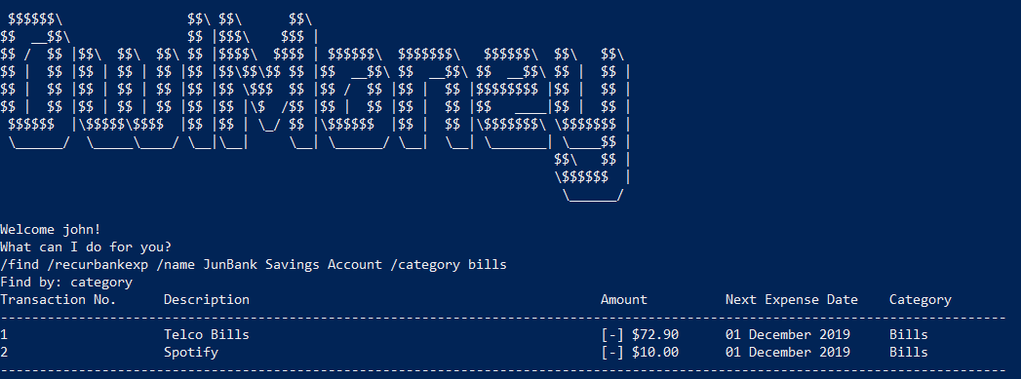
Command entered
Successful search of recurring expenditure by category

Slide 10
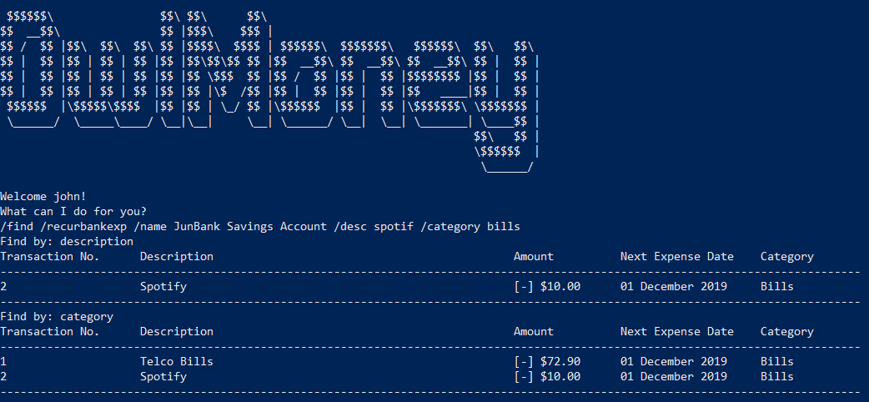
Command entered
Successful search of recurring expenditure by description and category

Slide 11
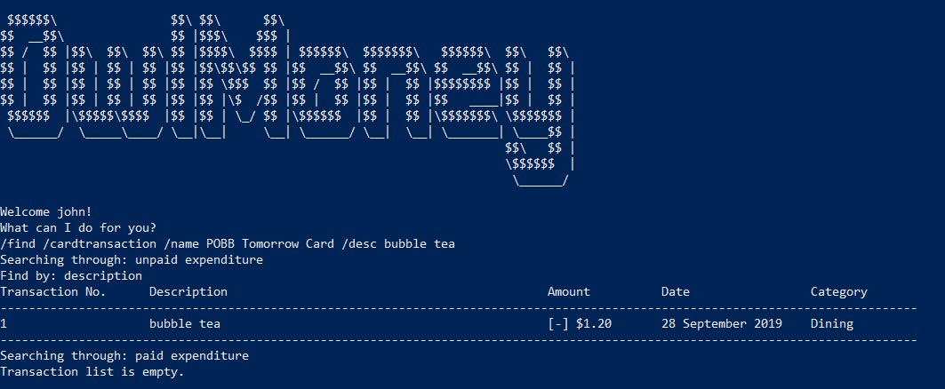
Command entered
Successful search of card transaction by description

Slide 12
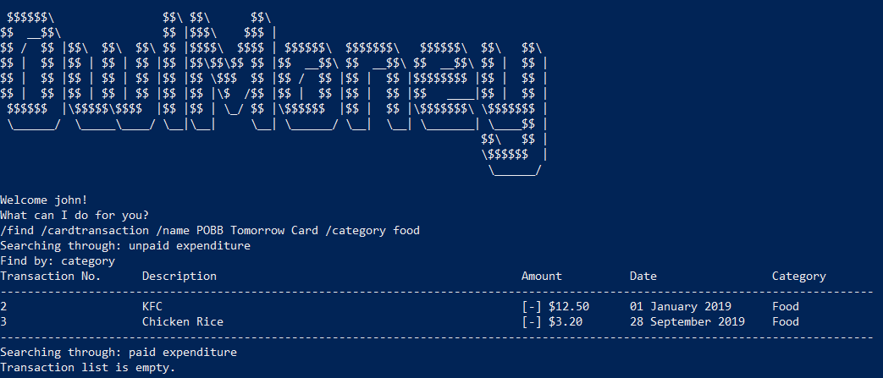
Command entered
Successful search of card transaction by category

Slide 13
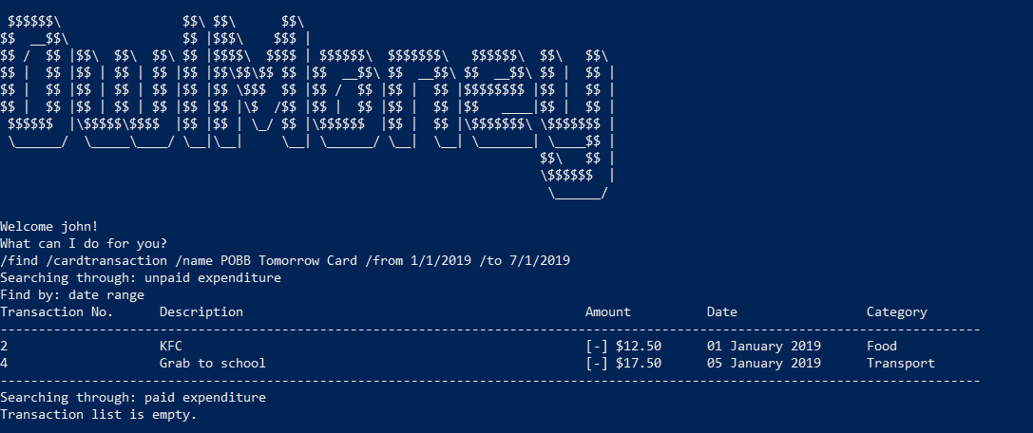
Command entered
Successful search of card transaction by date range

Slide 14
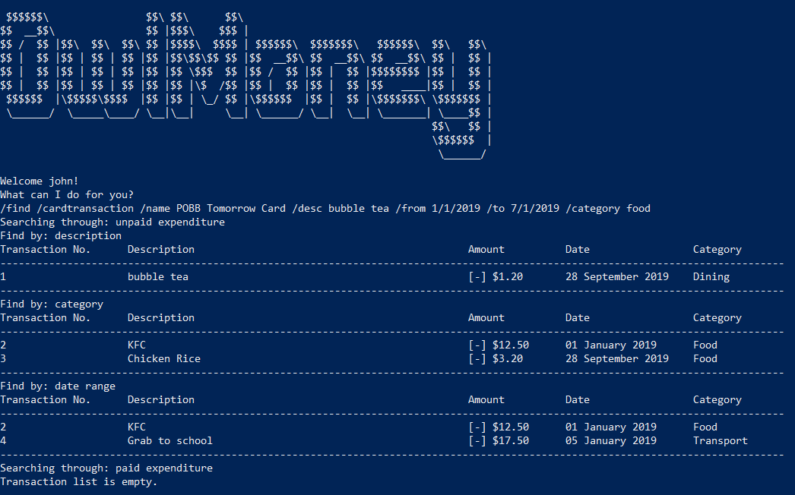
Command entered
Successful search of card transaction description, category and date range

